Slide 1

Learn programming with
KELVIN
+6281219644314
kelvindsmn@gmail.com

Slide 2

VALUES & VARIABLES
In this course we will learn about the following concepts :
Numeric Value
Variables
Assignment
Identifier
Reserved word

Slide 3
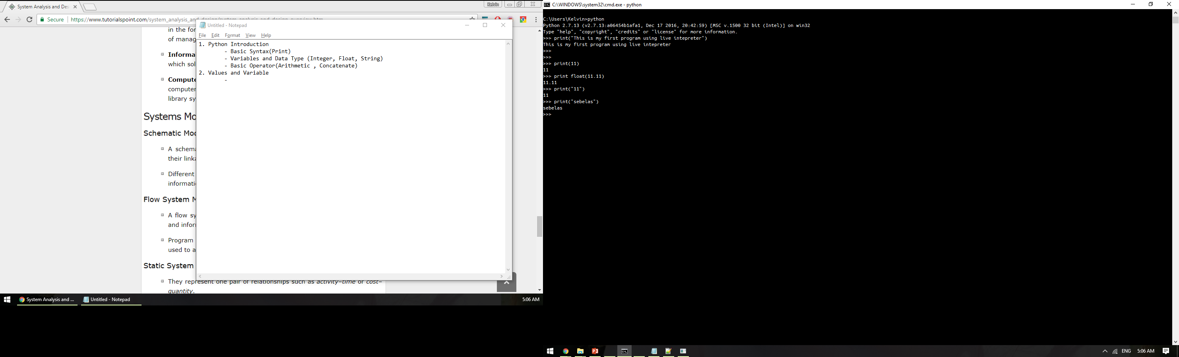
DATA TYPE
Integer
A whole number without fractional parts
Float
A whole number with fractional parts
Integer
float
String
A text that is start and end with (“ ”) or (‘ ’)
string

Slide 4
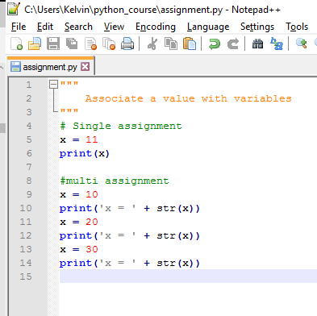
ASSIGNMENT
Assignment is how we associates value with the variable
x
10
x
10
20
10
x
20
30

Slide 5
IDENTIFIERS RULES
A good identifiers such as functions, classes, methods and variables follow this rules:
Identifiers must be related to its purpose
Identifiers must contain at least 1 character
First character must be alphabet or underscore
The remaining character may be alphabet, number or underscore
No other character allowed
A reserved word cannot be used as an identifier
camelCase or separated by underscore(_)

Slide 6
RESERVED WORD
and
as
assert
break
class
continue
def
del
elif
else
except
False
finally
for
from
global
if
import
in
is
lambda
none
nonlocal
not
or
pass
raise
return
try
True
while
with
yield

Slide 7
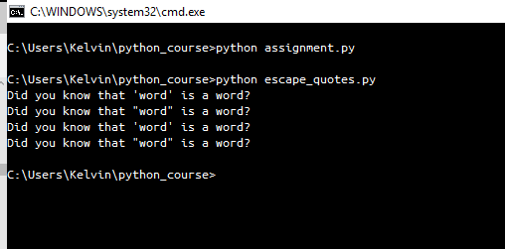
STRING CONTROL
print("Did you know that 'word' is a word?")
print('Did you know that "word" is a word?')
print('Did you know that \'word\' is a word?')
print("Did you know that \"word\" is a word?")

Slide 8
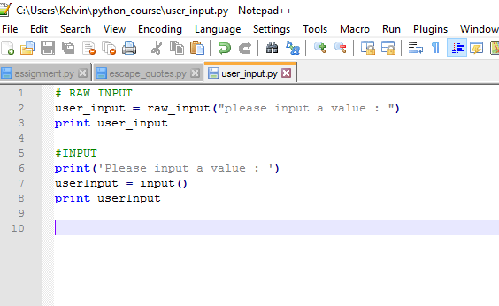
USER INPUT

Slide 9
ADD CALCULATOR
Create a program that takes 2 number that is inputted by user and the output is sum of that 2 number
Example :
11 + 11 = 22

